Slide 1
3000x3000x300m grid
Without pumping
Obs 4
WTD: 51.6 m
K: 8.4 m/d
(0,2600)
K1 = 11 m/d
K2 = 5 m/d
K3 = 1 m/d
Obs 3
WTD: 50.2 m
K: 1 m/d
(2300,2300)
dx = 100m
dy = 100m
dz = 300 m
Assumptions
Wildcat farm is approximately square
ACME is approximately twice as tall as wide
Hydraulic conductivity gradient can be represented by three averaged constant-K zones
(0,2500)
(1000,2500)
Farm 2
1800 m
Direction of GW flow w/o pumping
1000 m
(0,700)
(1000,700)
(1500,500)
(1800,500)
Obs 2
WTD: 5.4 m
K: 13 m/d
(24,0)
Wildcat
Obs 1
WTD: 4.8 m
K: 1.5 m/d
(2400,0)
y
400 m
300 m
Datum(0,0)
(1500,100)
(1800,100)
x

Slide 2
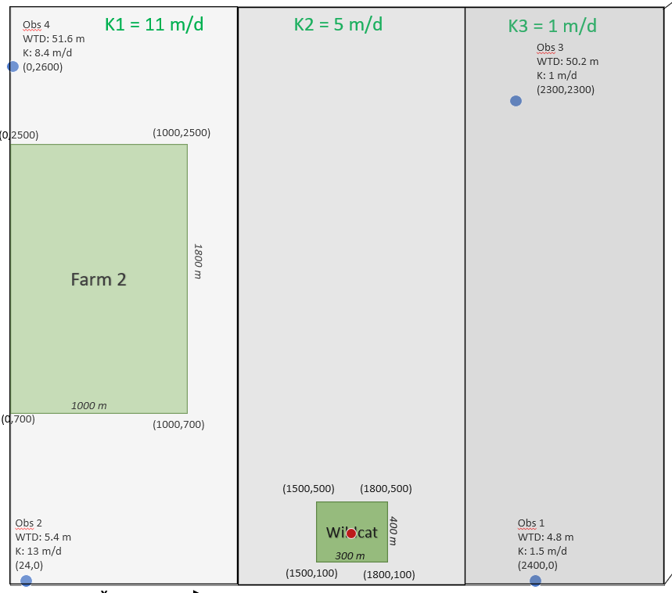

Slide 3
3000x3000x300m grid
Without pumping
Obs 4
WTD: 51.6 m
K: 8.4 m/d
(0,2600)
K1 = 11 m/d
K2 = 5 m/d
K3 = 1 m/d
Obs 3
WTD: 50.2 m
K: 1 m/d
(2300,2300)
dx = 100m
dy = 100m
dz = 300 m
Assumptions
Wildcat farm is approximately square
ACME is approximately twice as tall as wide
Hydraulic conductivity gradient can be represented by three averaged constant-K zones
(0,2500)
(1000,2500)
Farm 2
1800 m
Direction of GW flow w/o pumping
1000 m
(0,700)
(1000,700)
(1500,500)
(1800,500)
Obs 2
WTD: 5.4 m
K: 13 m/d
(24,0)
Wildcat
Obs 1
WTD: 4.8 m
K: 1.5 m/d
(2400,0)
y
400 m
300 m
Datum(0,0)
(1500,100)
(1800,100)
x

Slide 4
3000x3000x300 m grid
Obs 1
WTD: 4.8 m
K: 1.5 m/d
(2400,50)
Obs 2
WTD: 5.4 m
K: 13 m/d
(24,0)

Slide 5
Direction of GW flow
25x25x30 grid
1 cell = 100m
dx = 100 m
dy = 100 m
dz = 300 m
Obs 1
WTD: 4.8 m
K: 1.5 m/d
(0,24)
Obs 3
WTD: 50.2 m
K: 1 m/d
(23,23)
K = 1 m/d
1.5x1.5
Q1
Wildcat
Left Boundary
Constant head = 5 m
K = 6 m/d
Right Boundary
Constant head = 51 m
(1,15)
Assumptions
Wildcat farm is approximately square
ACME is approximately twice as tall as wide
Hydraulic conductivity gradient can be approximated by three averaged constant-K zones
3x5
ACME
Q2
K = 11 m/d
Obs 2
WTD: 5.4 m
K: 13 m/d
(0,0)
Obs 4
WTD: 51.6 m
K: 8.4 m/d
(25,0)
Q3
(7,0)

Slide 6
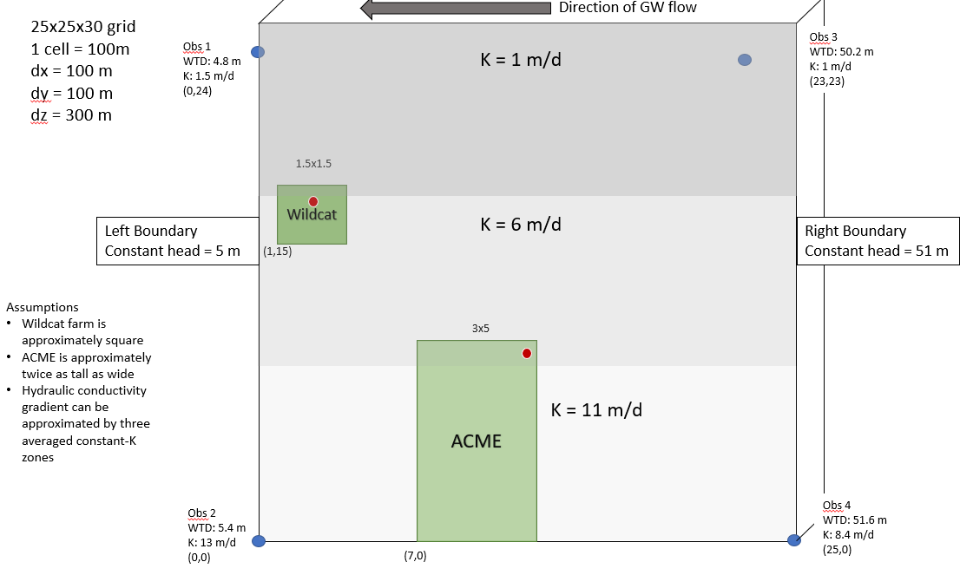
Wildcat Farm
Q = -20 m^3/day
Recharge = 5e-4
ET = Background ET = 5e-5
ACME Farm
Q1 = -20 m^3/day
Recharge = 5e-4
ET = Background ET = 5e-5
Q2 = -25 m^3/day

Slide 7
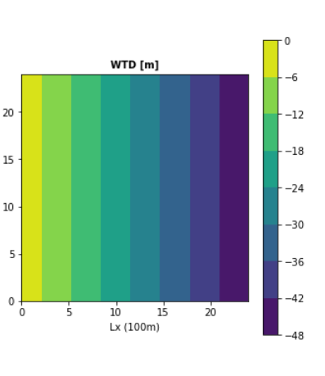
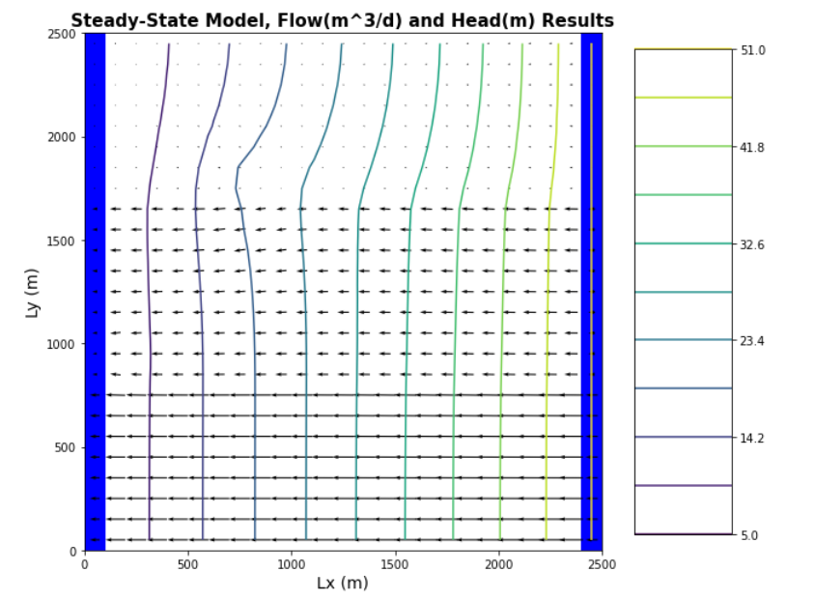
Pumping Wildcat well
w/o irrigation or recharge

